Slide 1
BERT model
Kiyan Rezaee – 22 July 2022

Slide 2
User intent User intent, otherwise known as query intent or search intent, is the identification and categorization of what a user online intended or wanted to find when they typed their search terms into an online web search engine for the purpose of search engine optimisation or conversion rate optimisation.^{[1]} Examples of user intent are fact-checking, comparison shopping or navigating to other websites.
https://en.wikipedia.org/wiki/User_intent

Slide 3
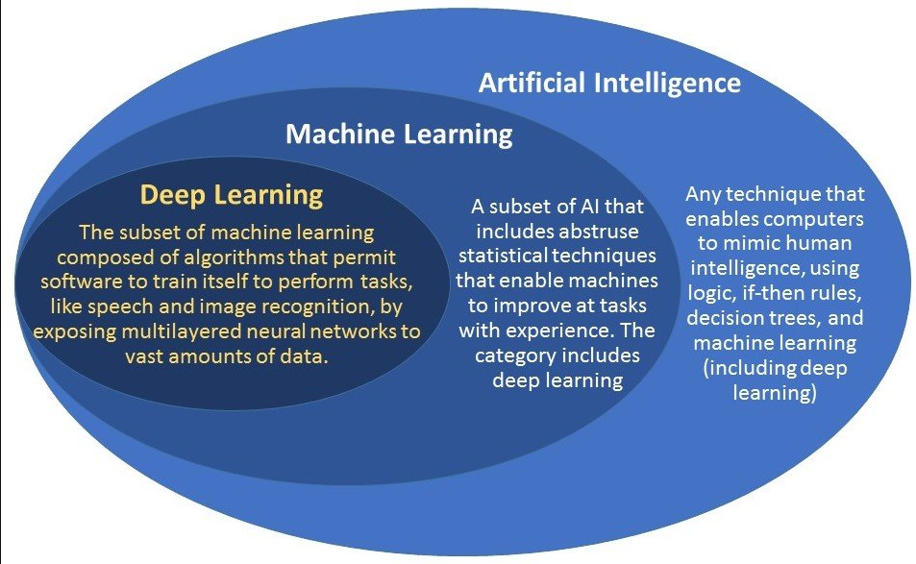
intelligence
AI
Machine learning
Deep learning

Slide 4
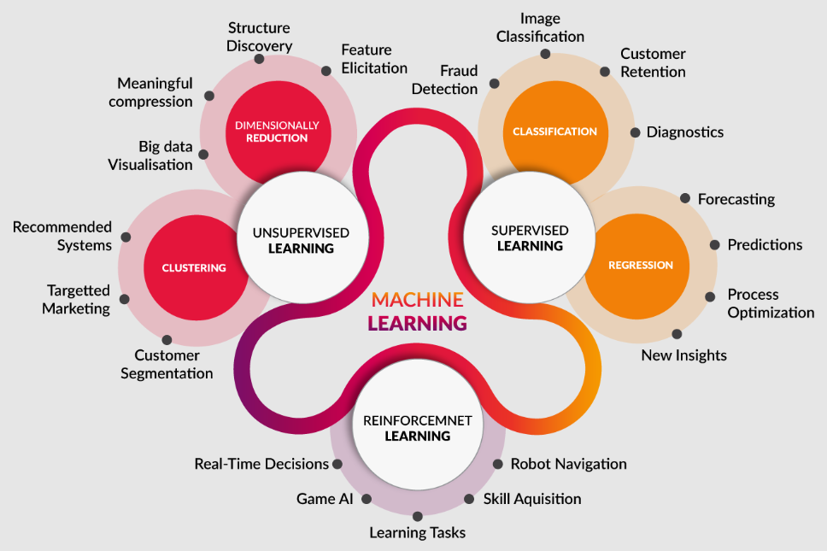
Machine Learning
supervised and unsupervised learning

Slide 5
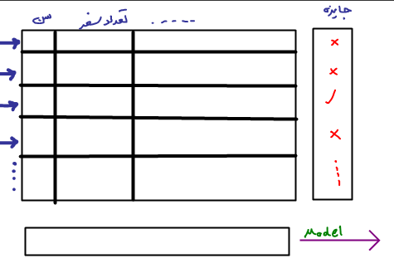
Model

Slide 6
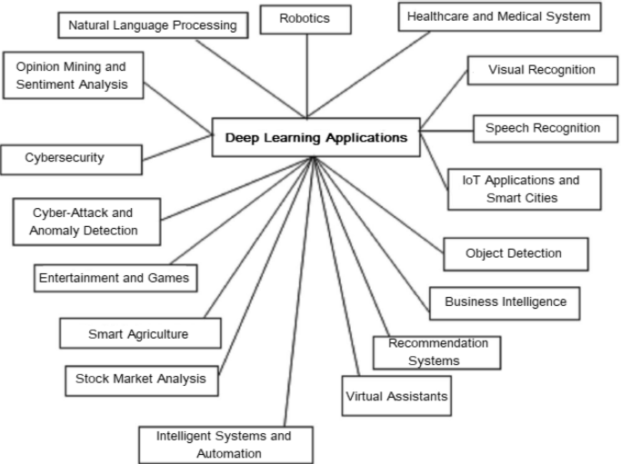
Deep learning

Slide 7
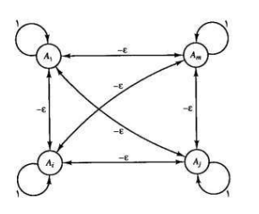
RNN
Recurrent neural network

Slide 8
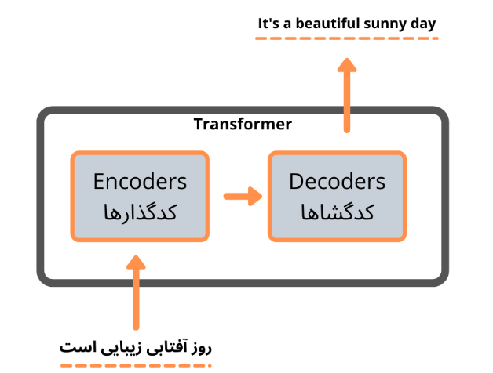
Transformers
Encoder–decoder architecture
Attention
Self-Attention
EX : Perceiver, GPT-3, BERT
https://arxiv.org/abs/1706.03762

Slide 9
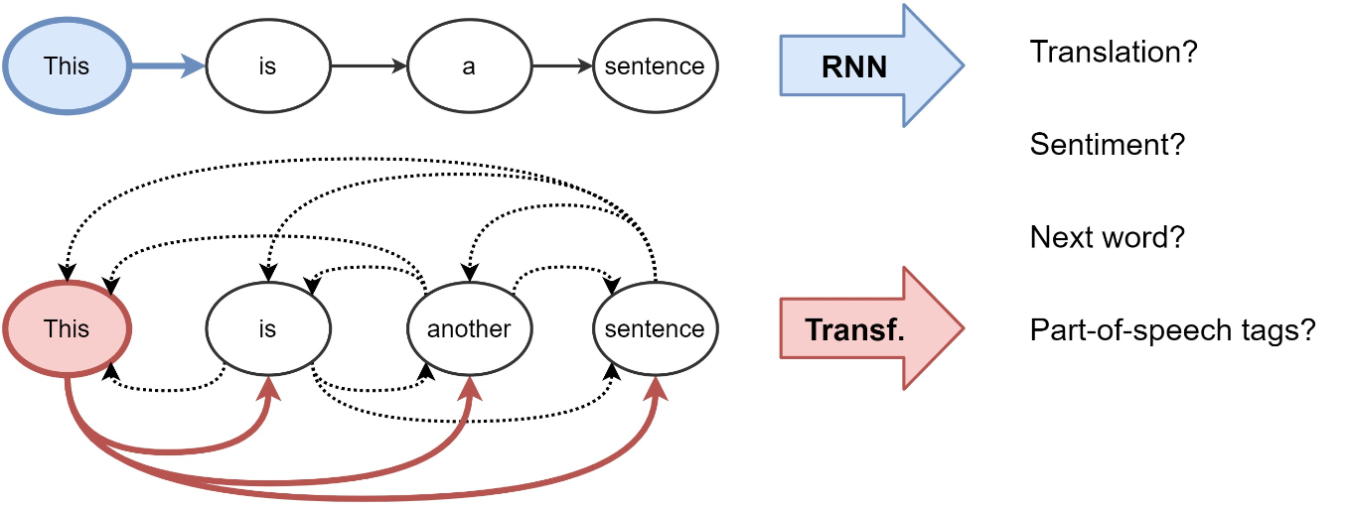
RNN vs Transformers

Slide 10
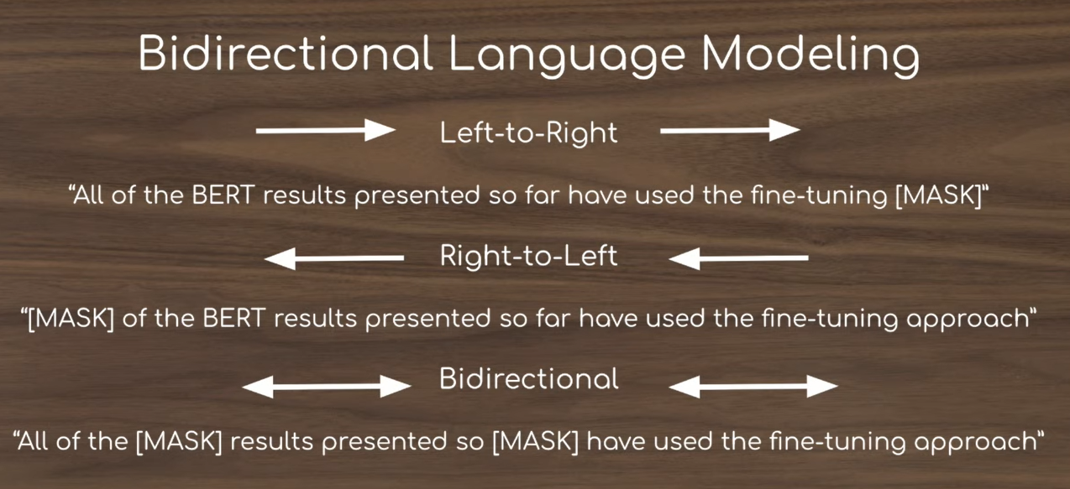
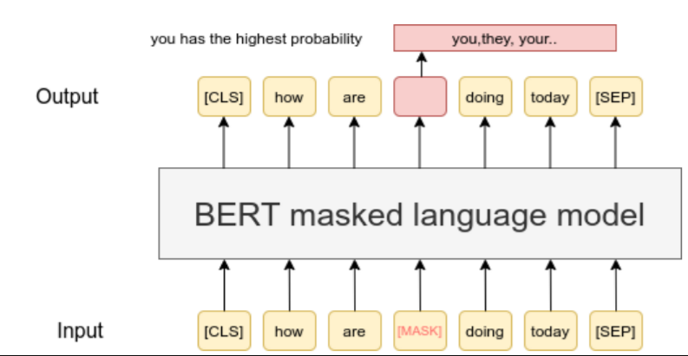
Bert model
Bidirectional Encoder Representations from Transformers (BERT)
Small dataset
Semi-supervised
Example…

Slide 11

Future works
preprocessing data(text)
Transformers in details
Other models like gpt-3
Bert model
…

